Slide 1
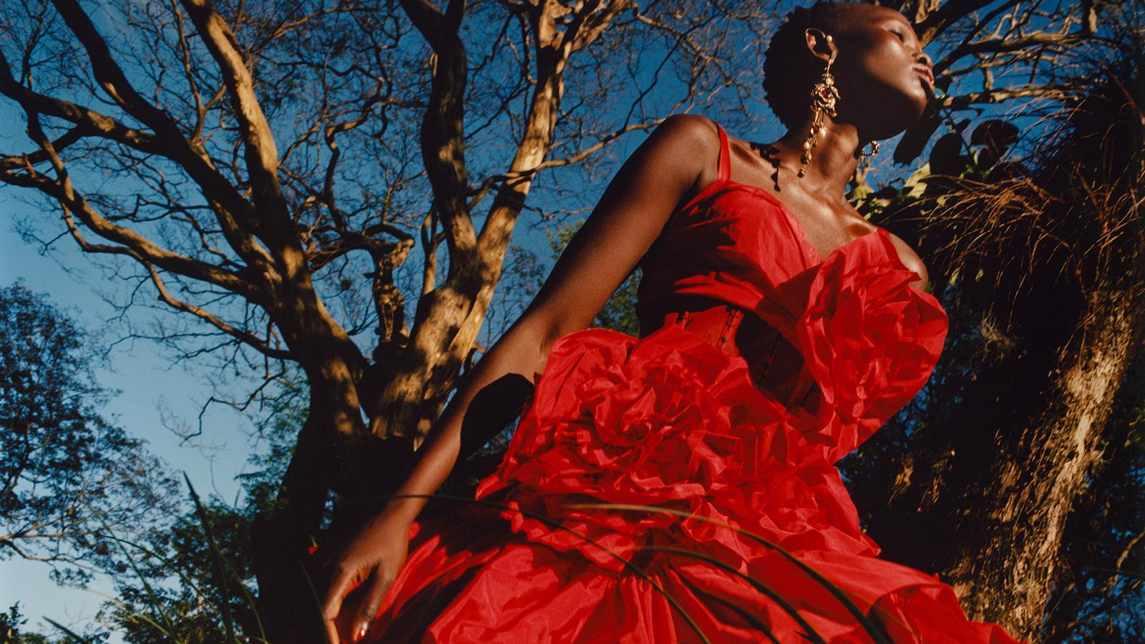
Alexander McQueen
Max Chang & Simone Gabrielli
Notes:
Max & Simone

Slide 2
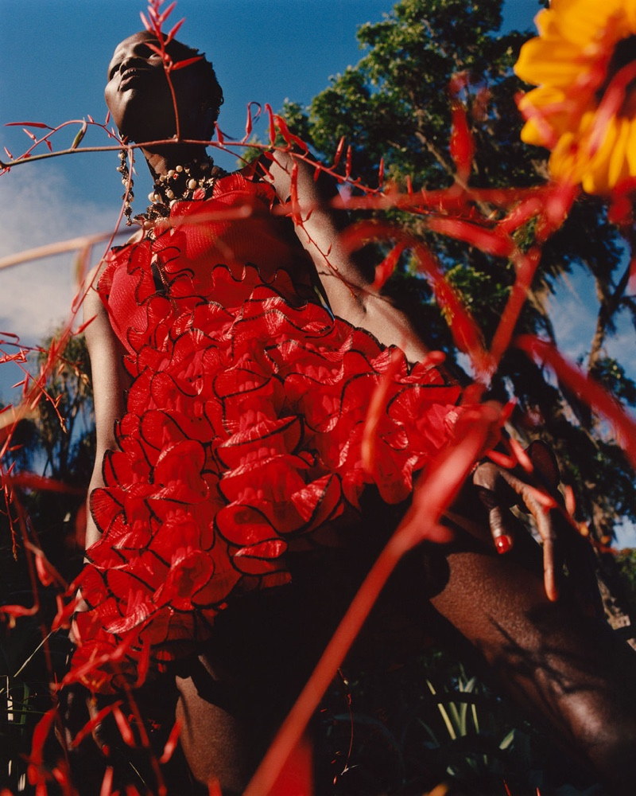
MCQueen
Or
Nah?
MET GALA 2018 EDITION
Notes:
Max

Slide 3
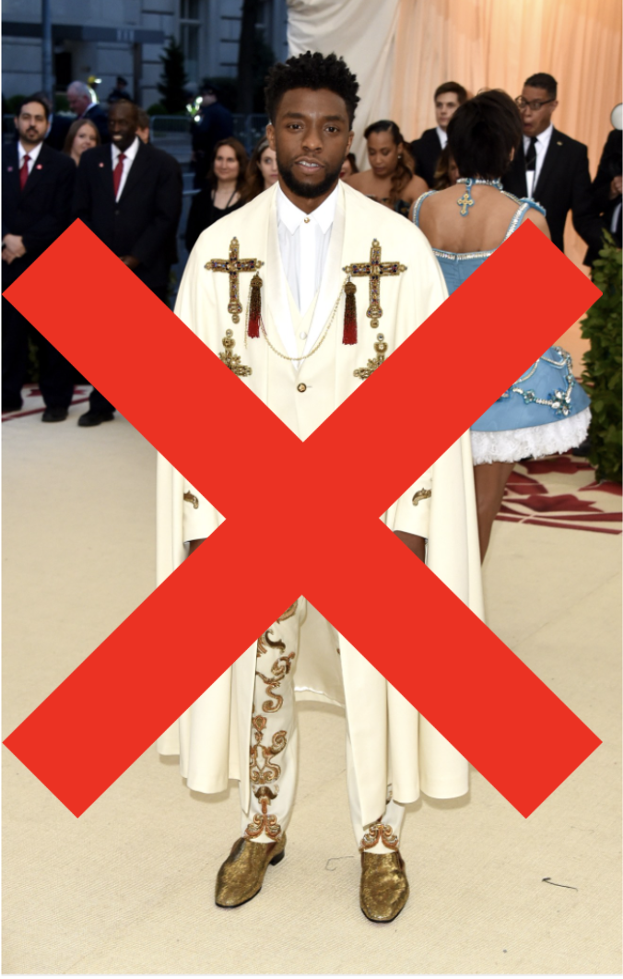
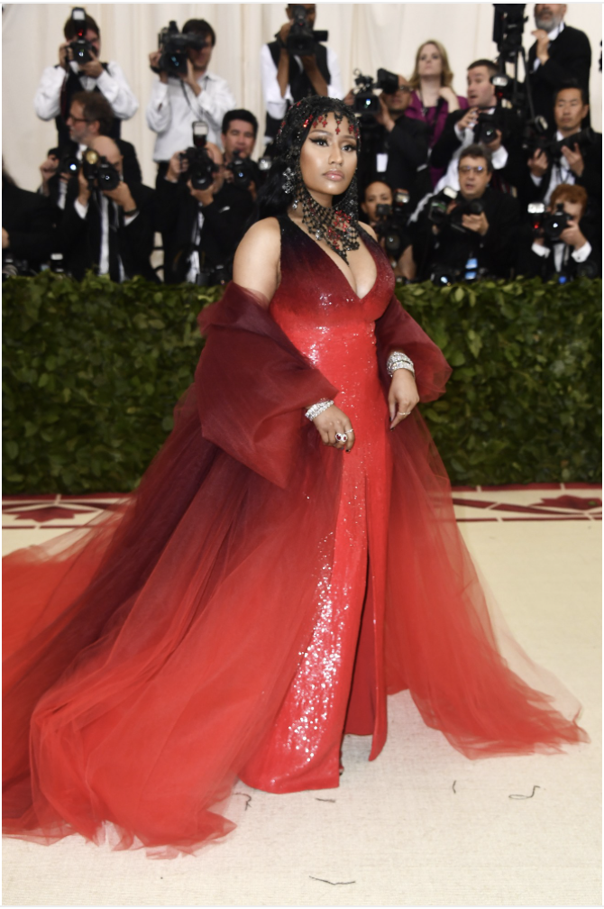
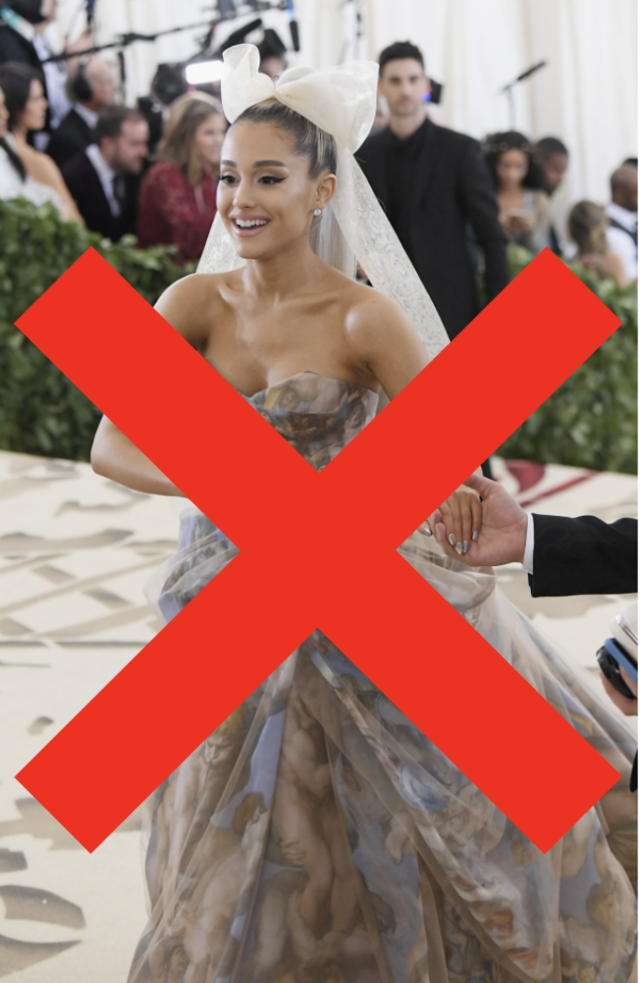
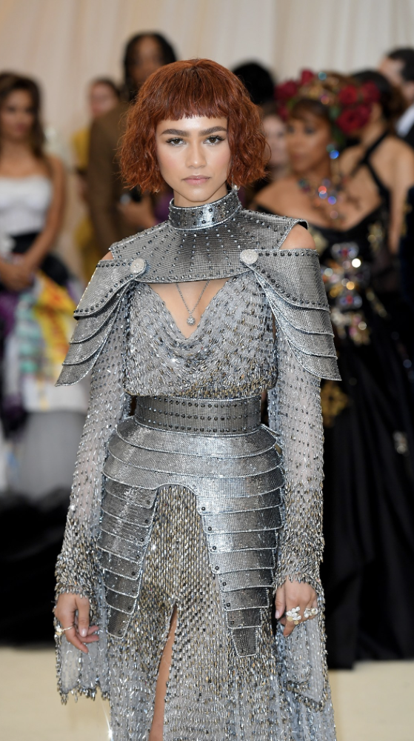
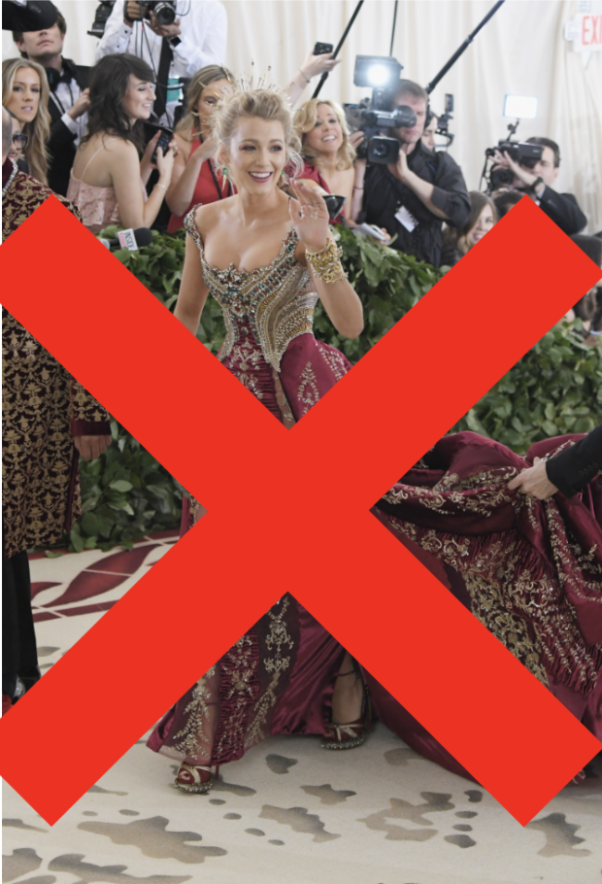
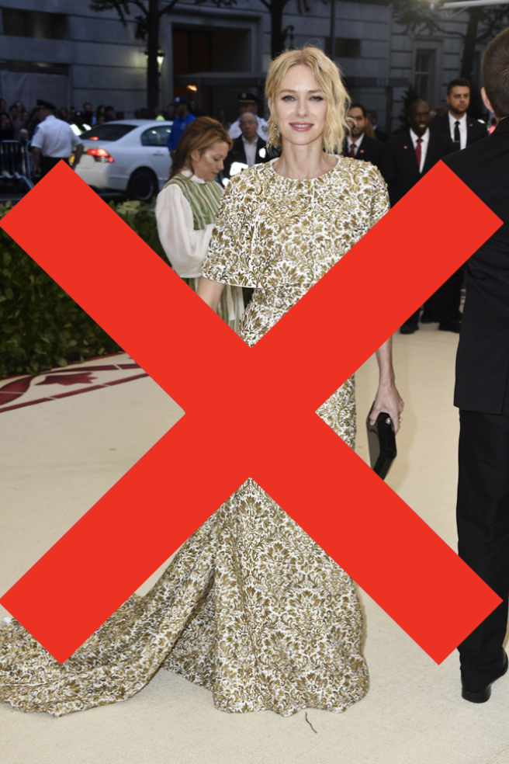
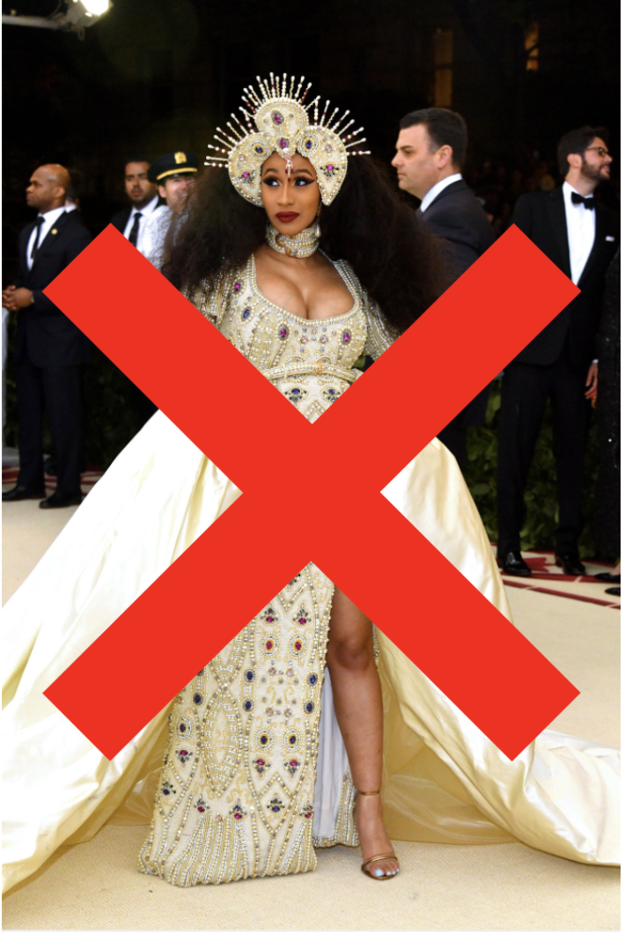
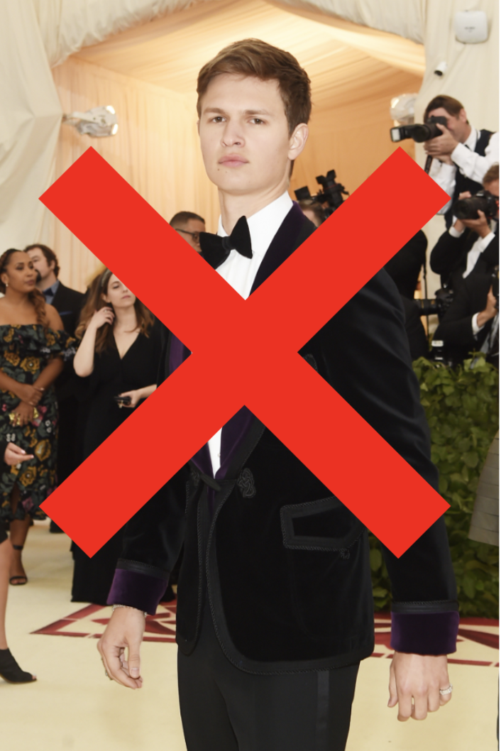
Biggest fashion night and no McQueen?
Notes:
Max

Slide 4
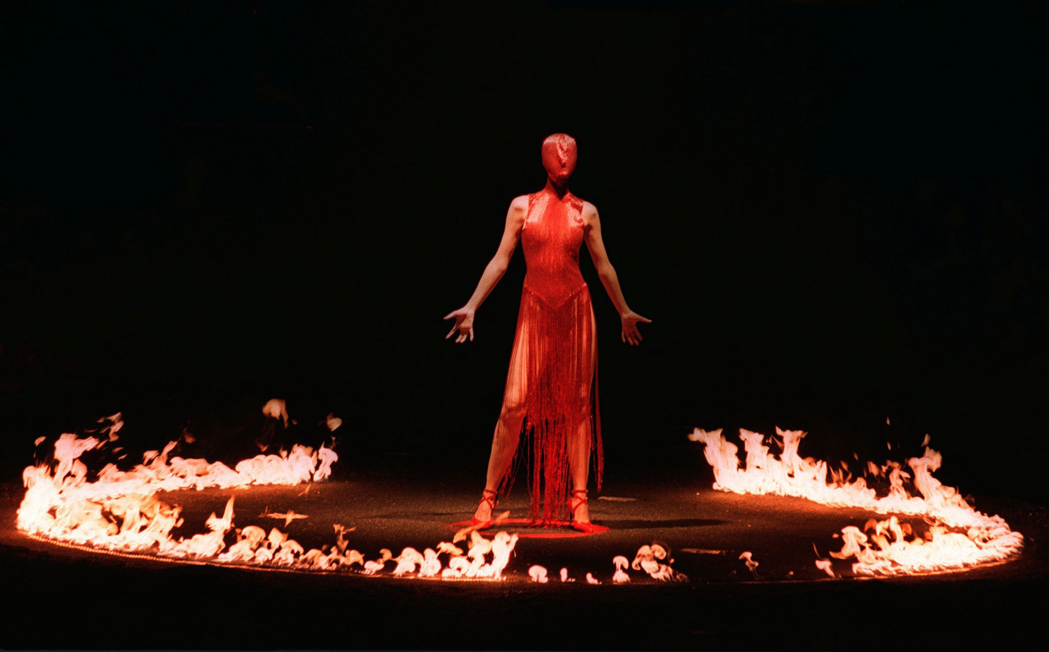
Lee has passed.
Is the brand still credible?
Is it still relevant?
Business Problem:
Notes:
Simone

Slide 5
The death of Alexander McQueen isn’t the end of the brand, it’s the rebirth of an art form that speaks on socio political issues that affect American people through couture.
One line
Notes:
Simone

Slide 6
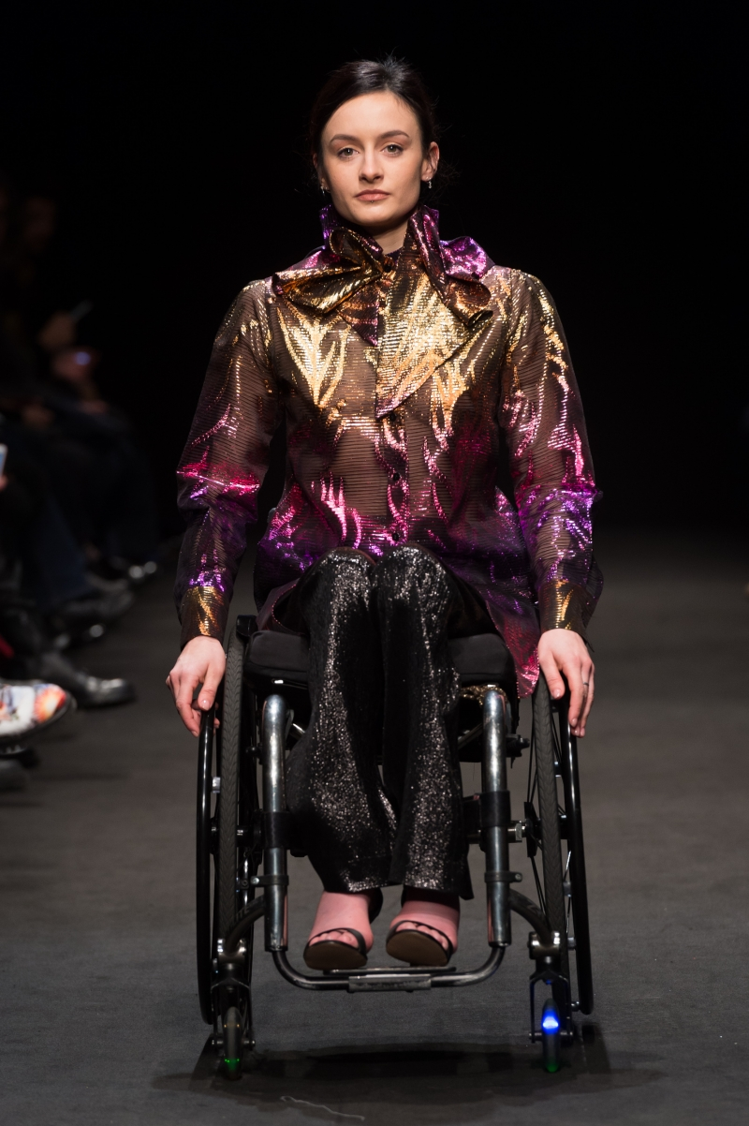
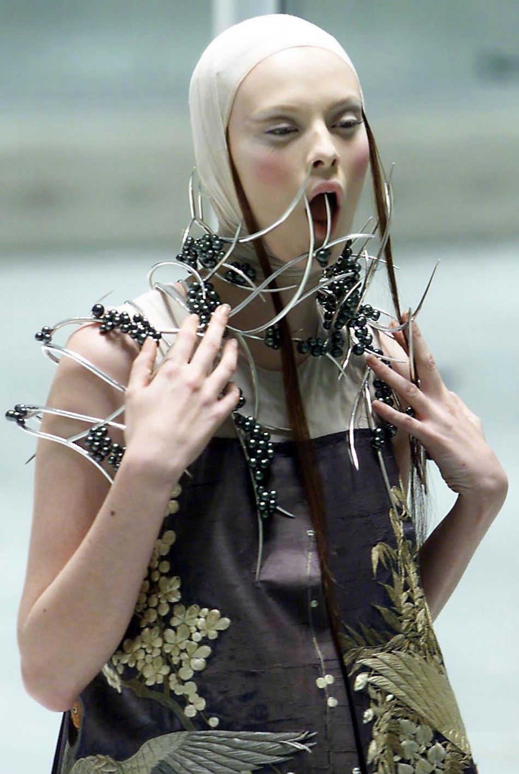
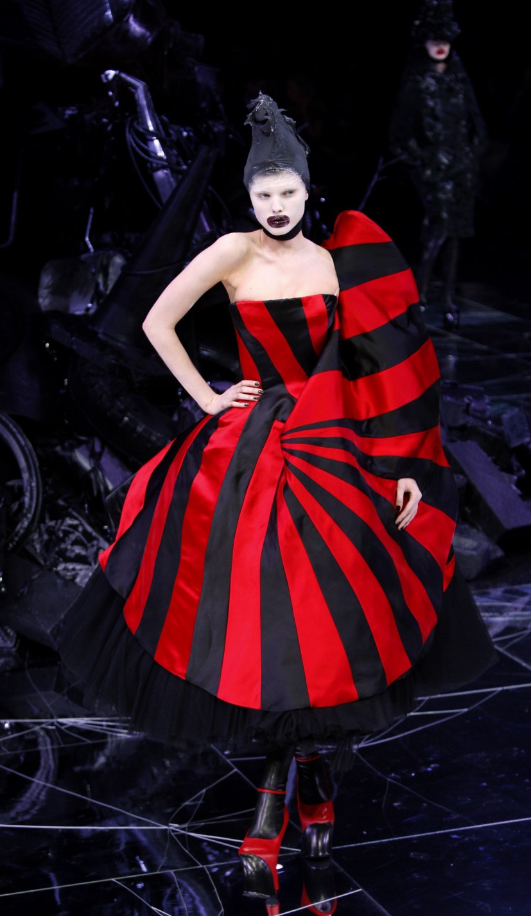
Notes:
Max

Slide 7
#queen4thepeople
Notes:
Simone

Slide 8
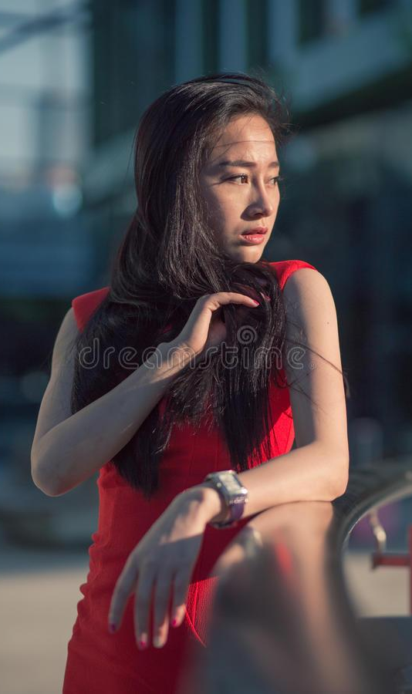
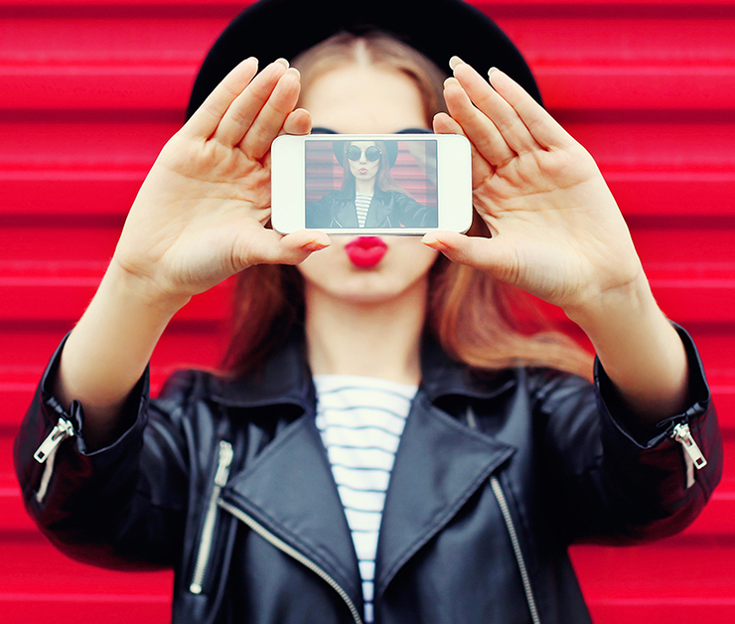
Who are the people?
Notes:
Simone

Slide 9
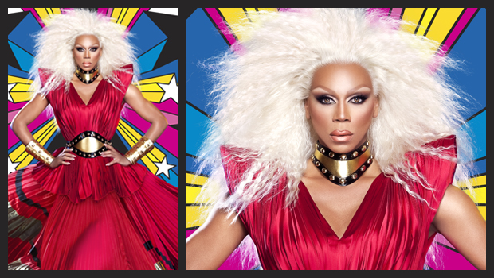
Partnership
Currently relevant?
Inherently political?
Fashion forward?
Notes:
Max

Slide 10
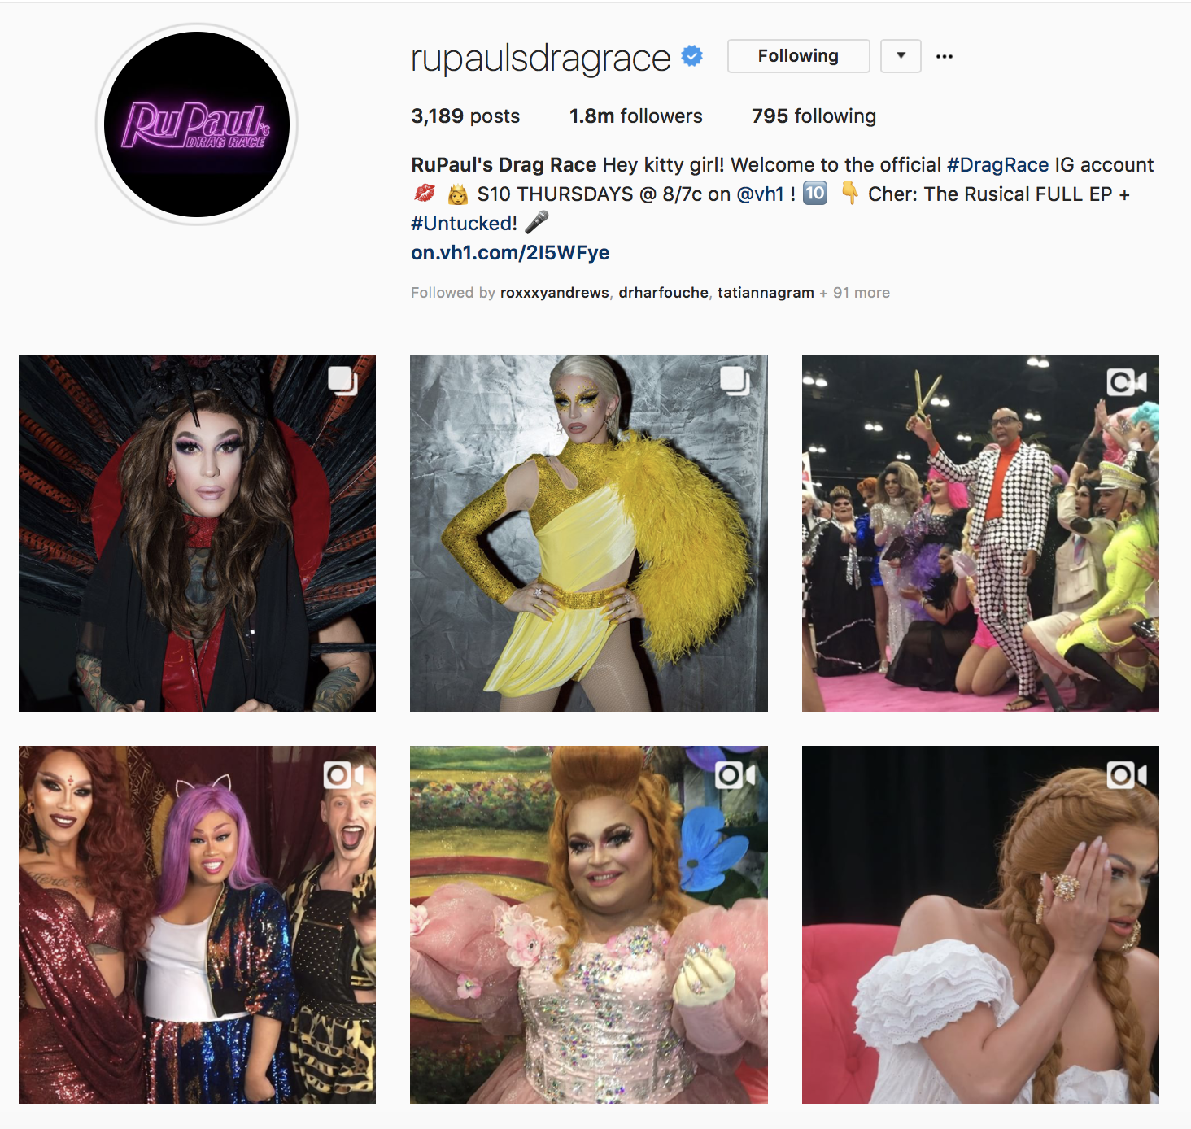
763,000 viewers per episode (VH1 and growing)
Insane, cult-like following
“Drag is inherently political”
Similar target audience
Notes:
Max

Slide 11
Don’t be a drag,
Be a mcQueen.
Notes:
Simone

Slide 12
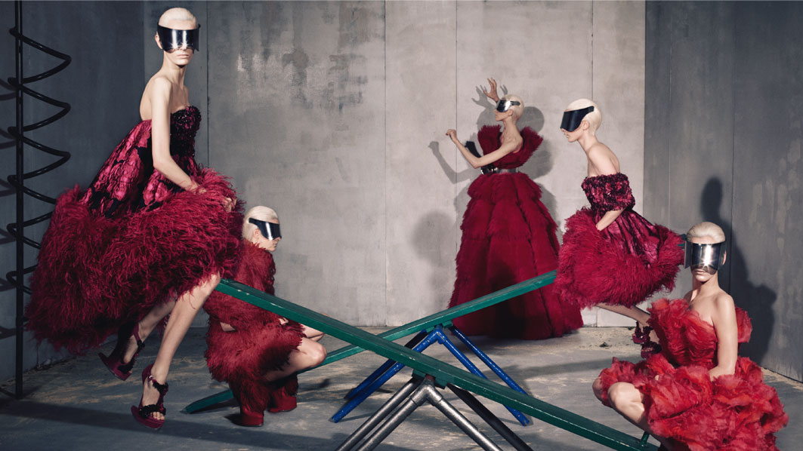
Campaign
specifics
Notes:
Simone

Slide 13
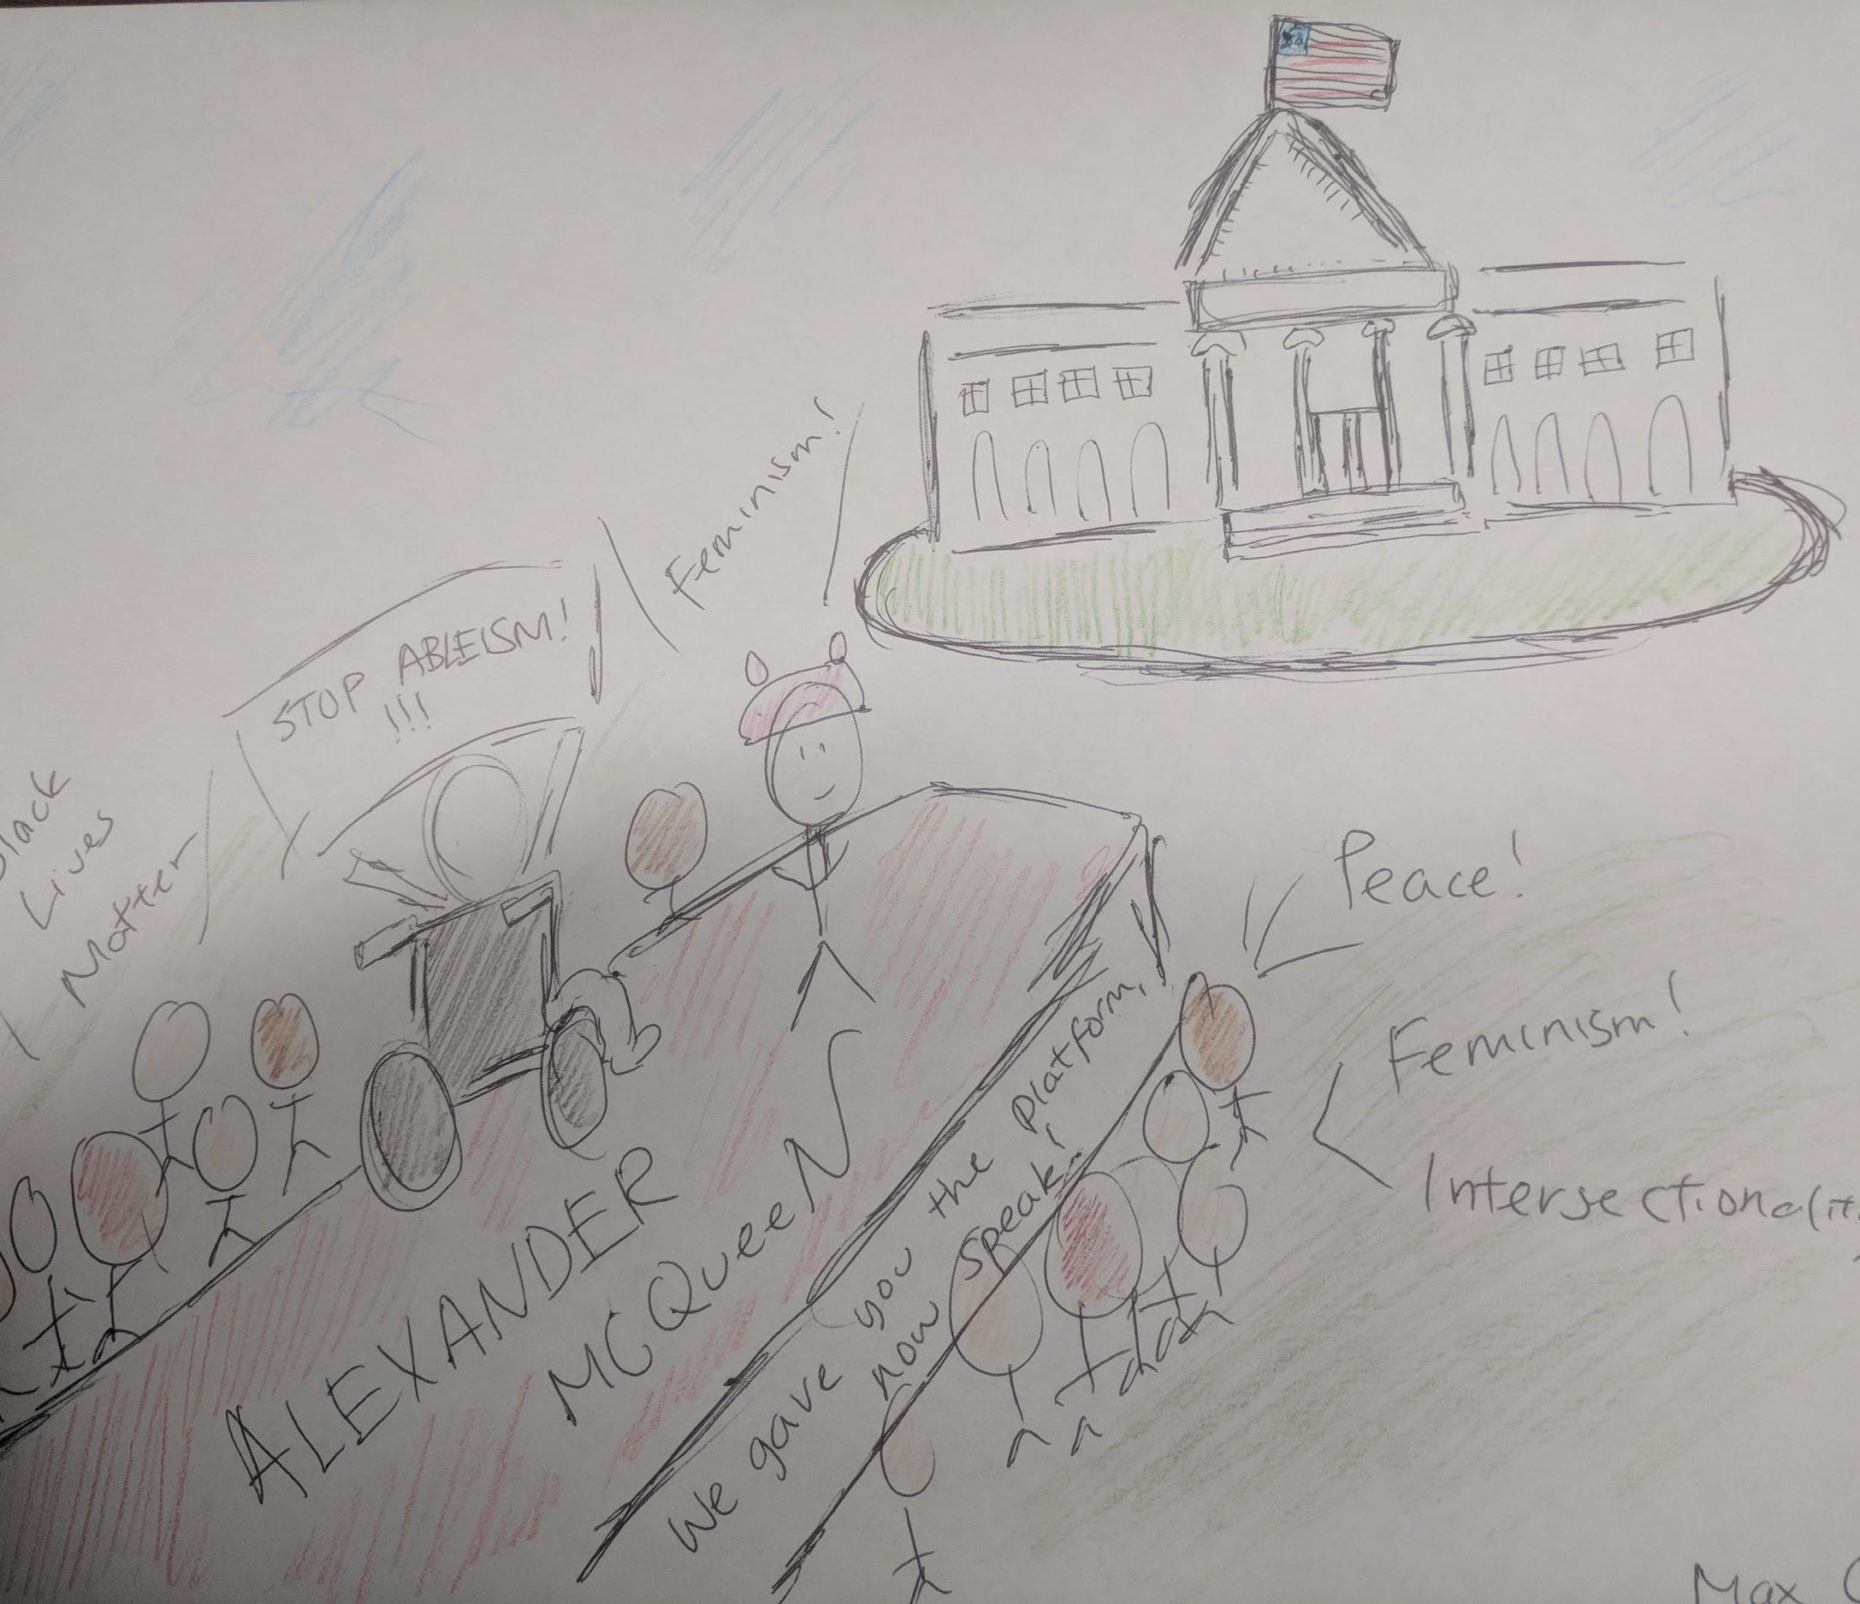
Outdoors
Campaign
#Queen4thePeople
Notes:
Simone

Slide 14
60%
Pure promotional material for collaboration between Queens & client
40%
Advertising toward “Queens for Change” event
Notes:
Max

Slide 15
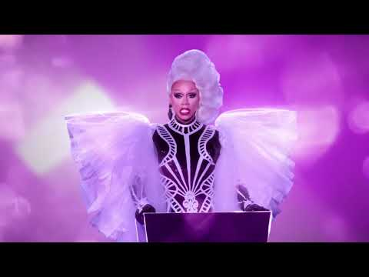
radio
Title: Don’t Be a Drag be a McQueen!
(RuPaul’s voice over the entire spot, have to buy licensing for the iconic drag race car soundtrack)
[Rupaul Charles]:
Hey Kitty Girl, want to Rule the World?
Well Don’t be a Drag…
be A McQueen.
*insert RuPaul Laugh Track*
[Ru]:
It’s me RuPaul Charles…
and I’ll be seeing you at “Drag Queens for Change” sponsored by the Alexander McQueen on June 26, 4:00PM in front of the White House.
Where Queens…
Meets, high, fashion.
Don’t be Drag, Be a McQueen!
Notes:
Max

Slide 16
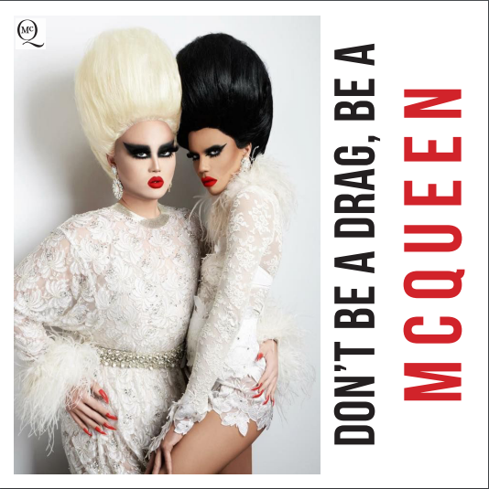
curated
Alexander McQueen
Social media
Be sure to attend Queens For Change, in front of the White House on June 26 at 4:00PM.
Category is.. Politics Extravaganza!!
Check out McQueen’s new
line featuring @kimchi and @naomismalls
#queen4thepeople
#AlexanderMcQueen
Notes:
Max

Slide 17
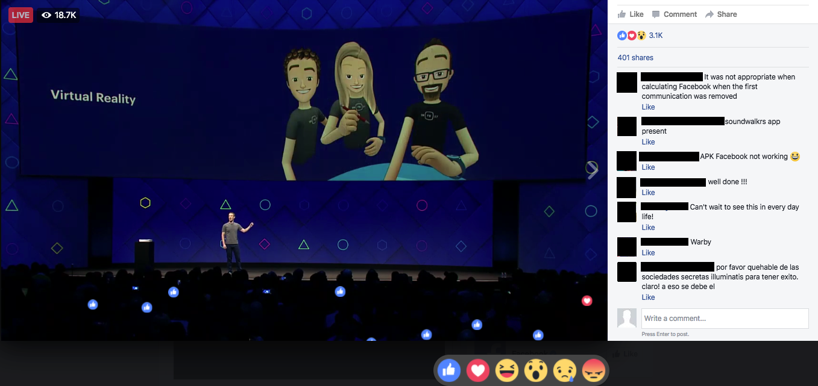
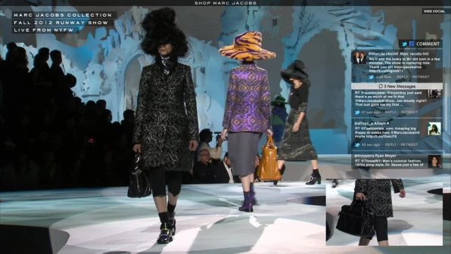
curated
Social media
RuPaulsDragRace
@itsraven giving you a preview of what she will be wearing at “Queens for Change!”
#queen4thepeople
#AlexanderMcQueen
Notes:
Max

Slide 18
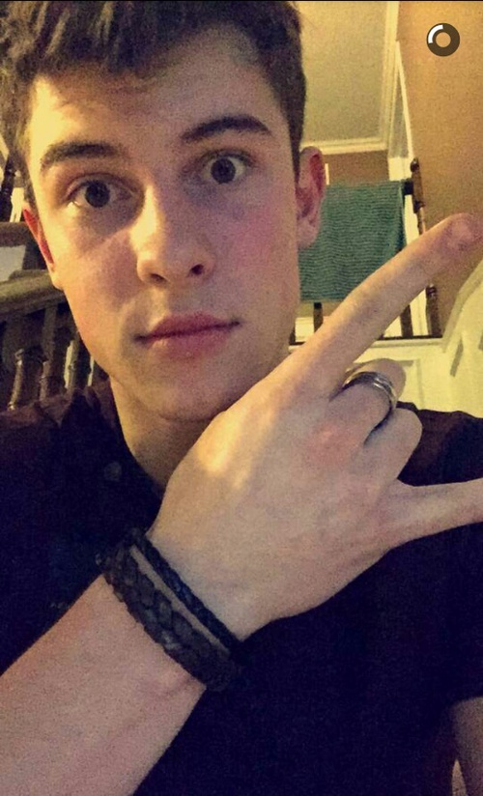
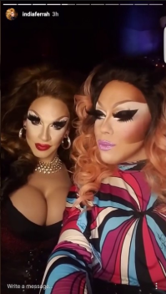
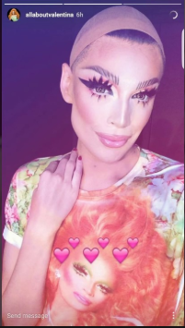
uncurated
Social media
Go follow @alexandermcqueen!
Getting ready for the Queens for Change Runway!!!
#queen4thepeople
Notes:
Simone

Slide 19
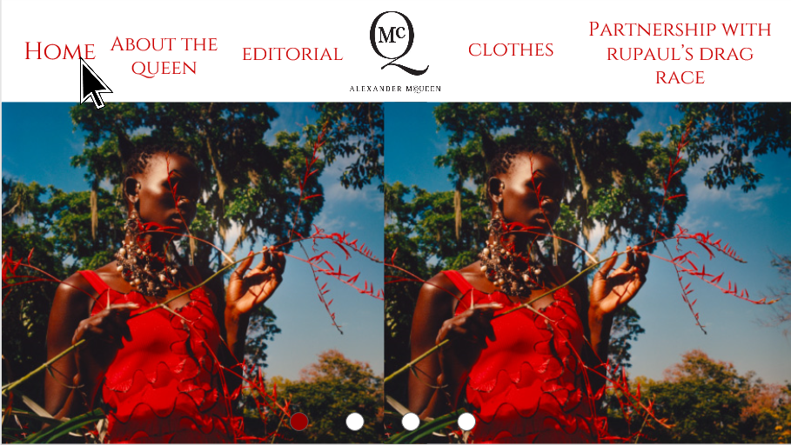
Notes:
Simone

Slide 20
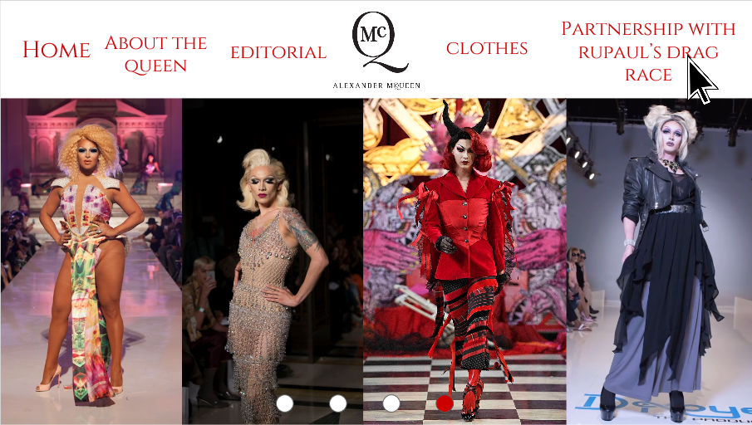
Notes:
Simone

Slide 21
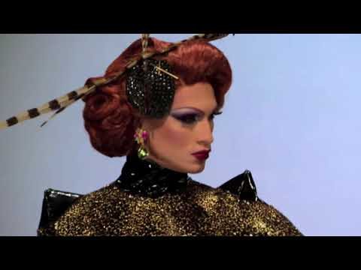
Tv spot
Pure promotional material for collaboration between Queens & client
Notes:
Max

Slide 22
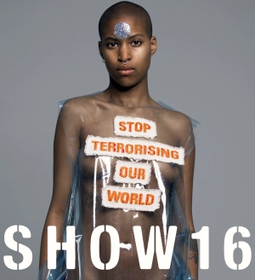
(attempting) Viral campaign
Under the hashtag, #Queen4thePeople post a photo of you expressing your political statement through fashion. What do you want to see change in our world? Post the photo, and tag 3 other people to accept the challenge.
Five lucky winners will be announced on the microsite and invited to walk at the Alexander McQueen Milan show in Fall 2018.
Max Chang
Build Bridges, Not Walls #Queen4thePeople
Notes:
Simone

Slide 23
The end
Notes:
Both

